Slide 1
Transformers
https://www.youtube.com/watch?v=zxQyTK8quyY

Slide 2
A lot can be said on how ChatGPT works, but fundamentally it is based on a Transformer

Slide 3
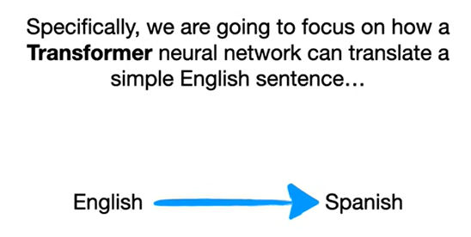

Slide 4
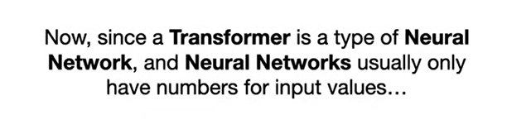

Slide 5
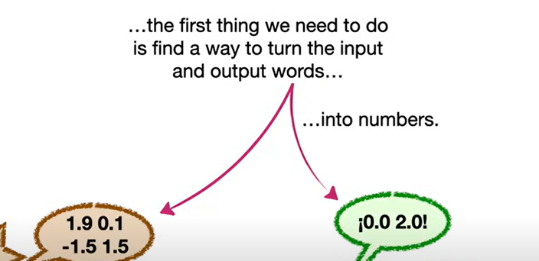

Slide 6
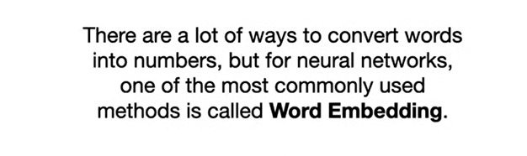

Slide 7
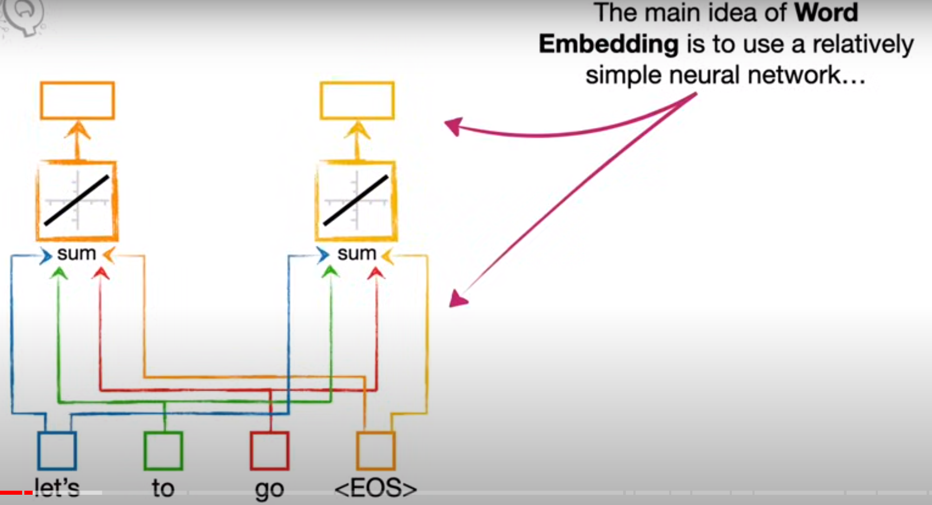

Slide 8
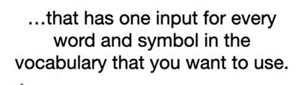

Slide 9
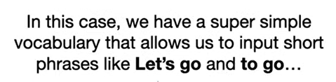

Slide 10
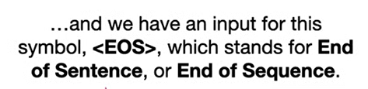

Slide 11
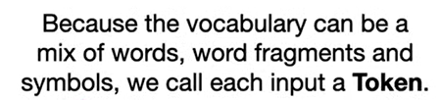

Slide 12
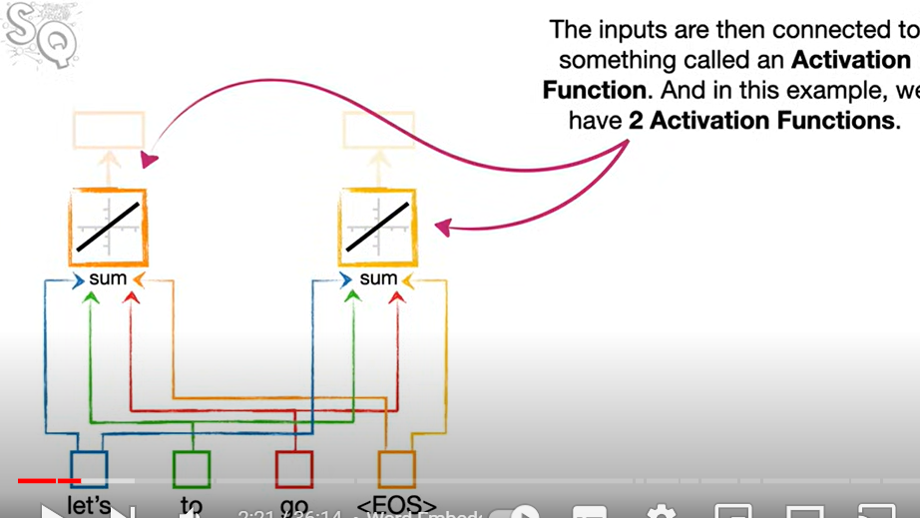

Slide 13
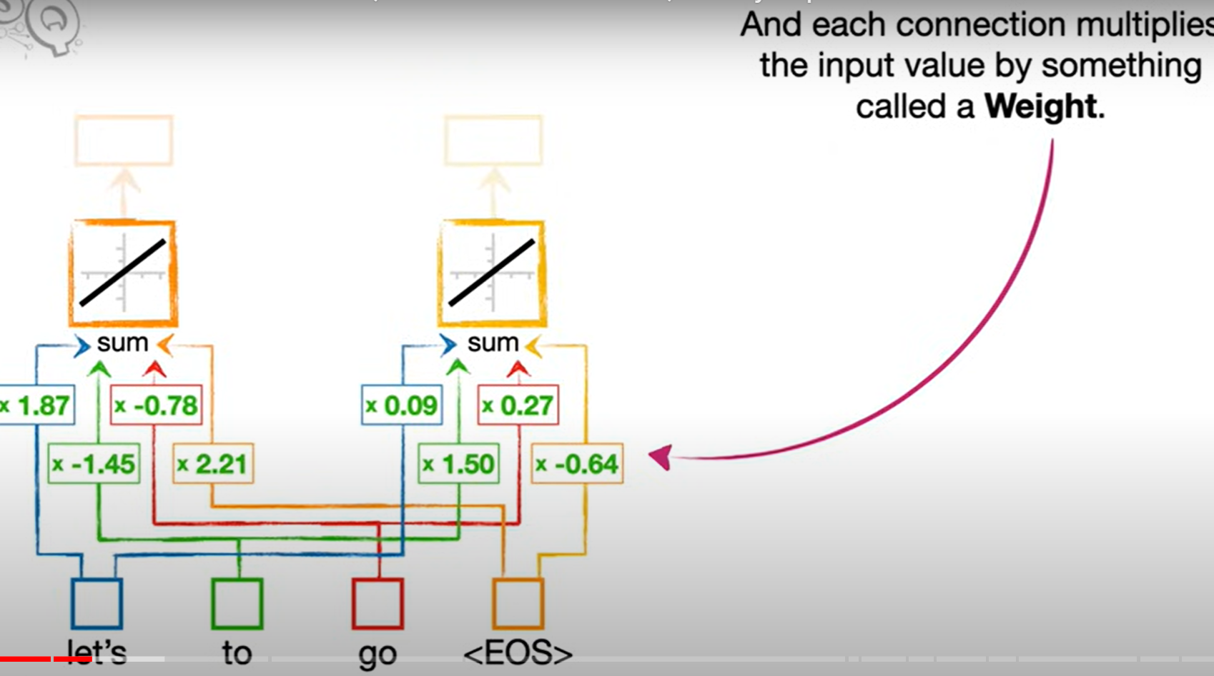
We have 2 activation functions, marked by orange boxes at the top

Slide 14
Where did the numbers come from? Will answer in a bit
For now we will convert the word Let’s into numbers

Slide 15
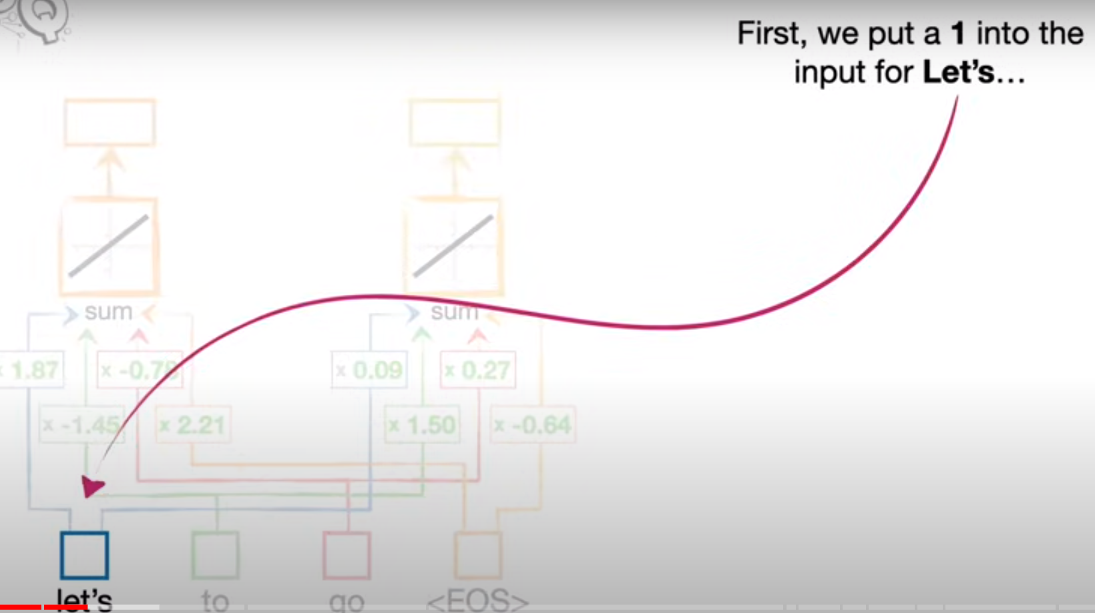

Slide 16
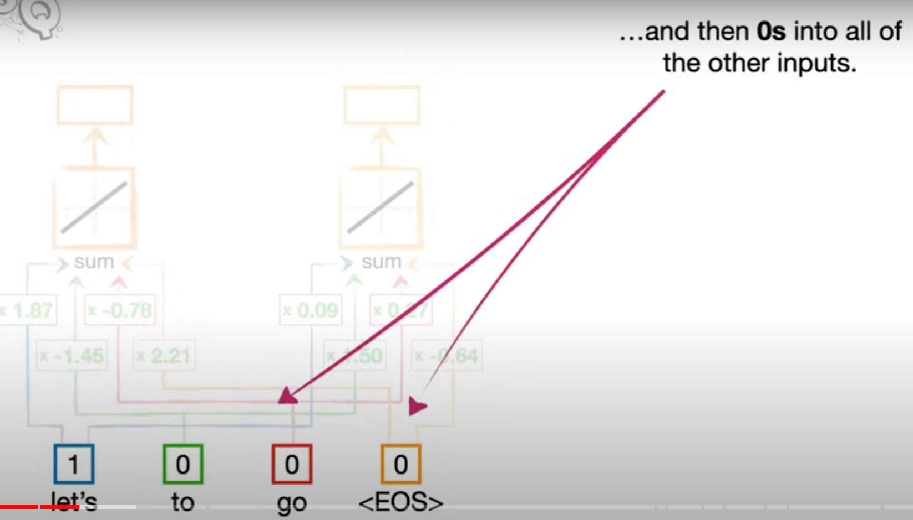

Slide 17
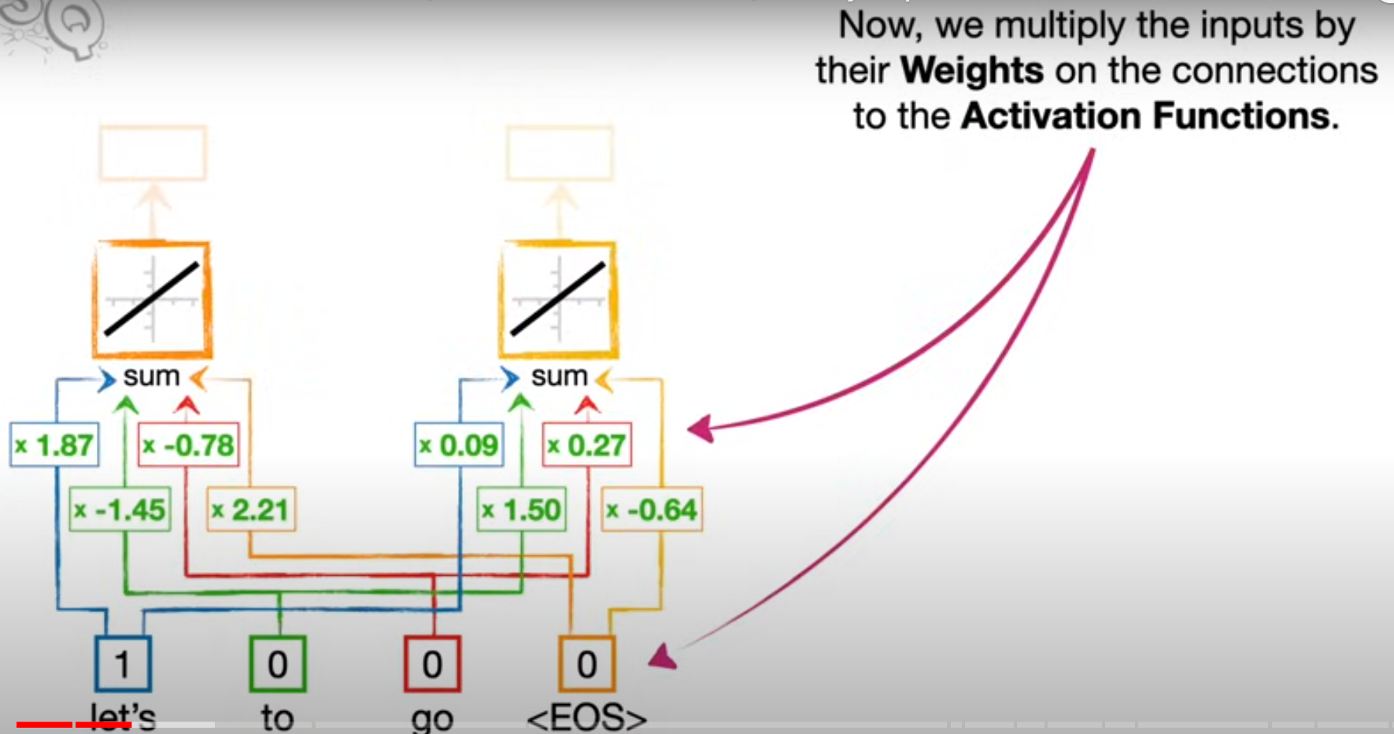

Slide 18
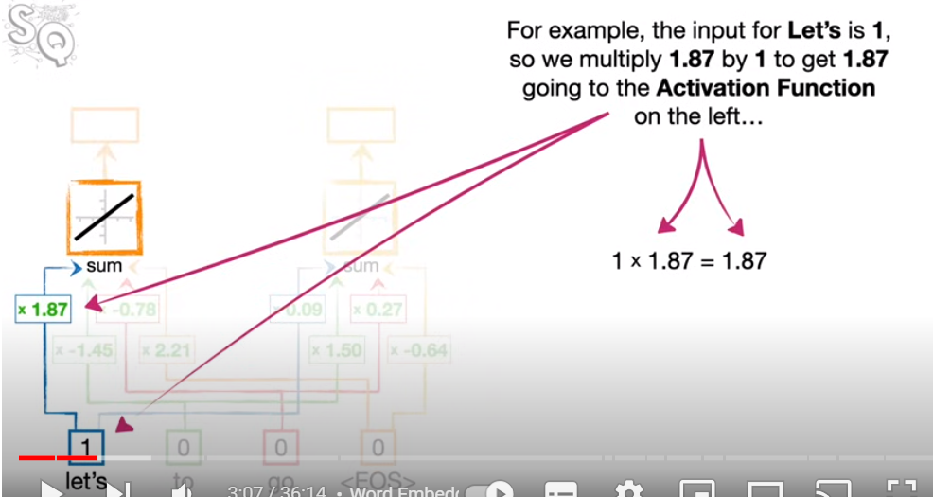

Slide 19
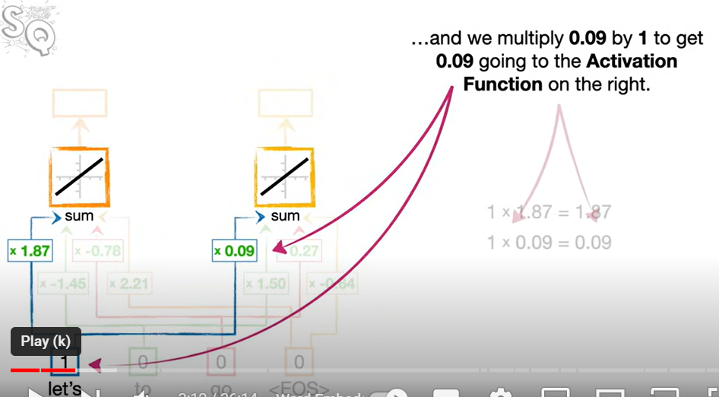

Slide 20
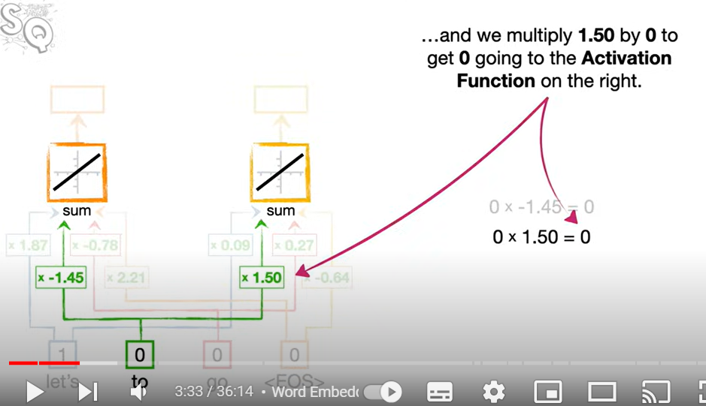

Slide 21
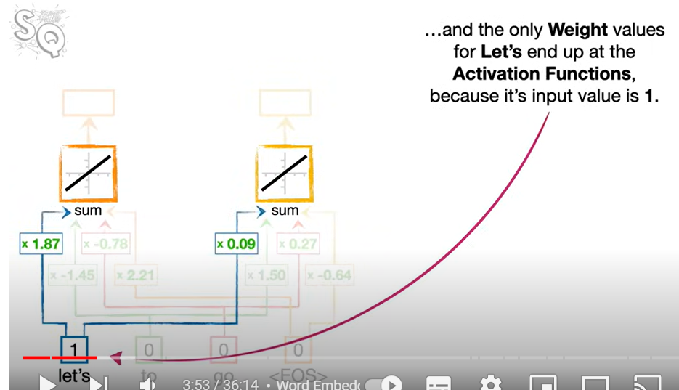
Similarly other words and eos all send 0 to the activation functions

Slide 22
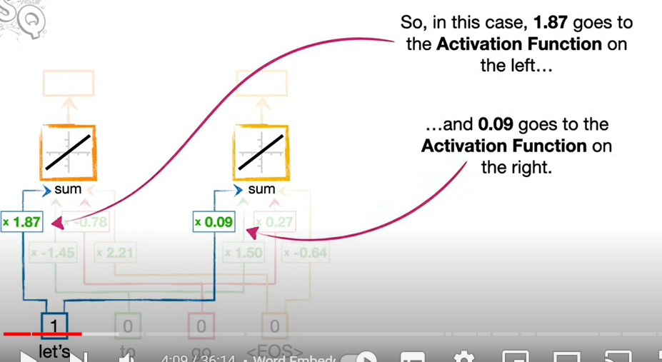

Slide 23
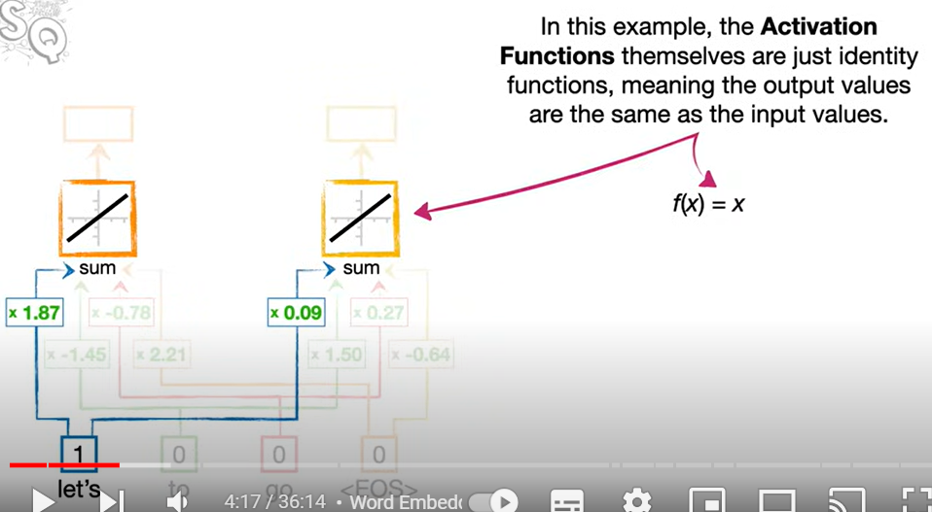
When do activation functions act as identity functions?

Slide 24
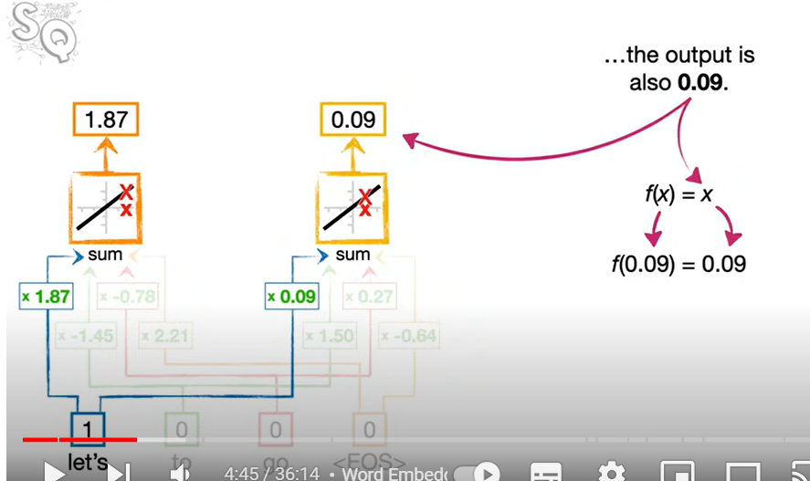

Slide 25
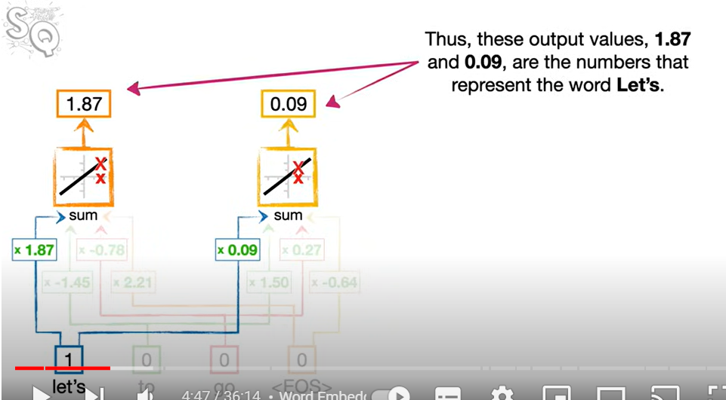

Slide 26
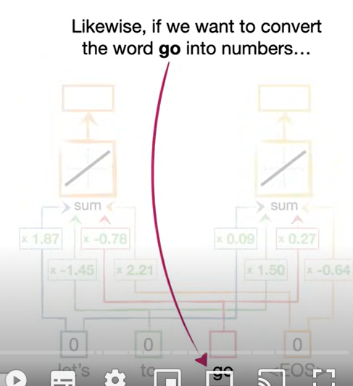

Slide 27
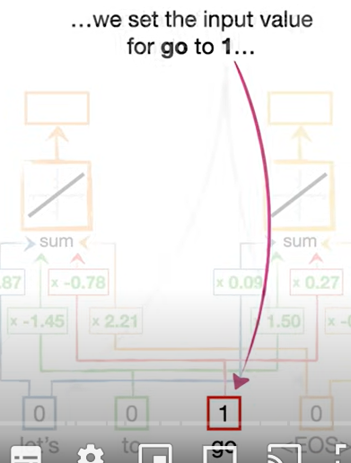

Slide 28
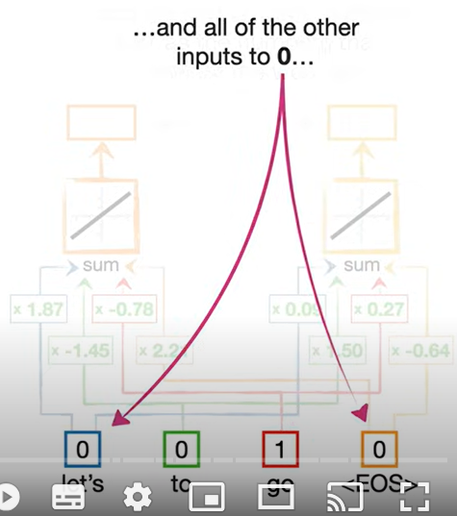

Slide 29
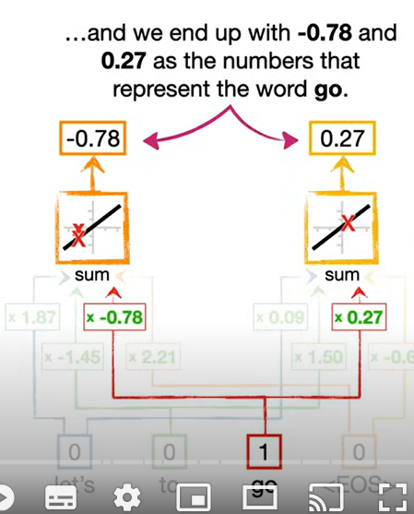

Slide 30
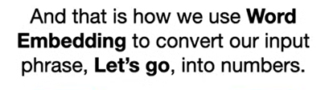

Slide 31
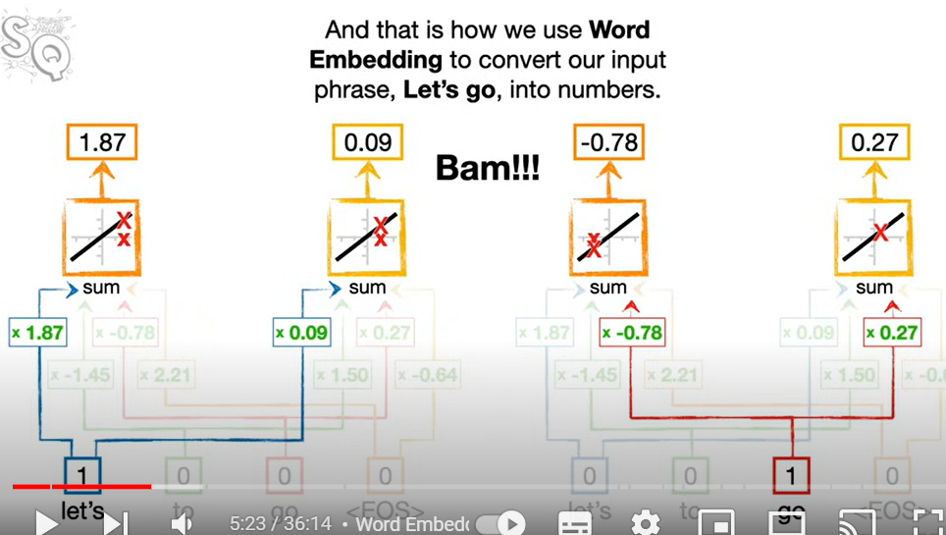

Slide 32
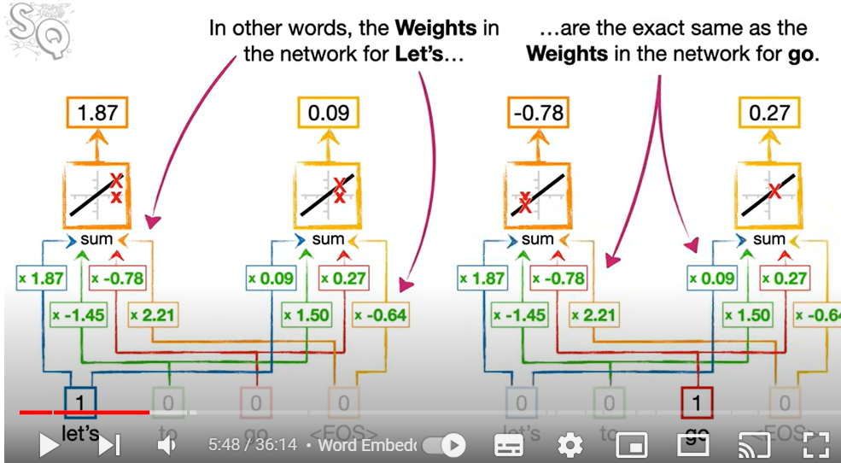
Important note

Slide 33
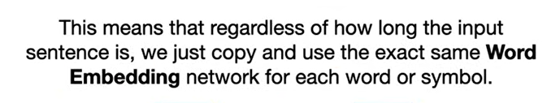

Slide 34
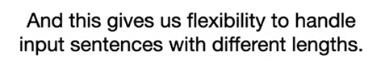

Slide 35
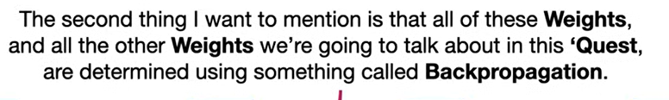

Slide 36
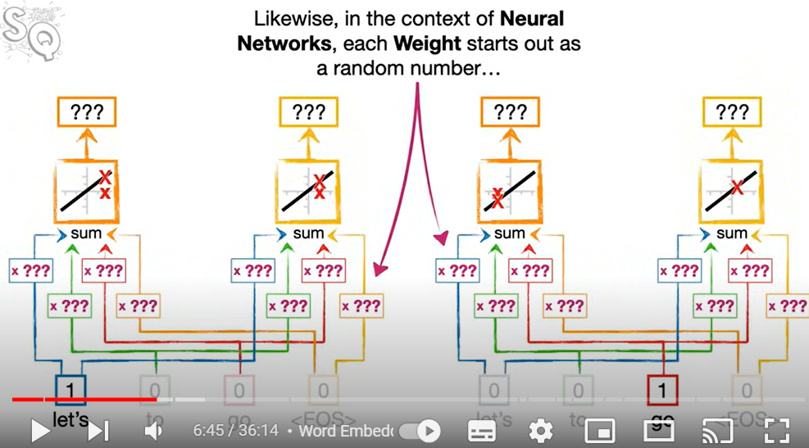
Just like in backpropagation, each weight in NN starts out as a random number, then iteratively we fine tune

Slide 37
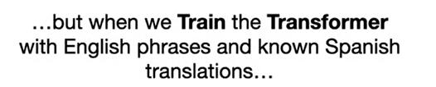

Slide 38
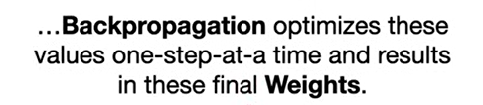

Slide 39
These are simple use-cases for backpropagation and training, real life is more complicated/sophisticated
More study would be required if you want to fully understand these techniques

Slide 40
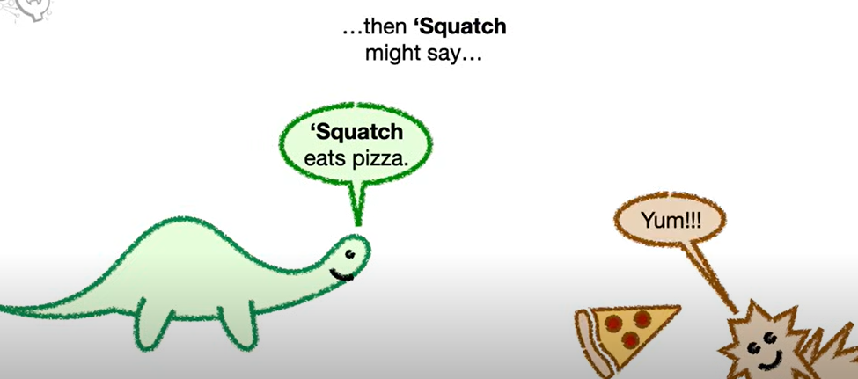
Word order

Slide 41
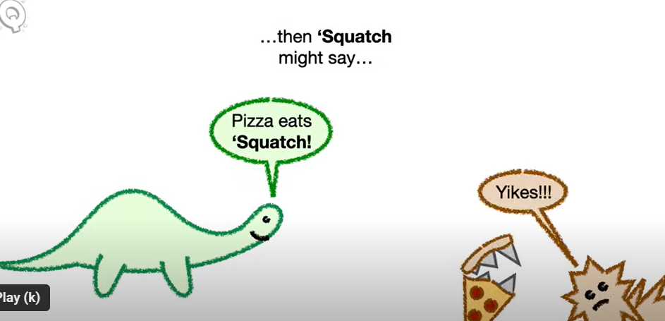

Slide 42
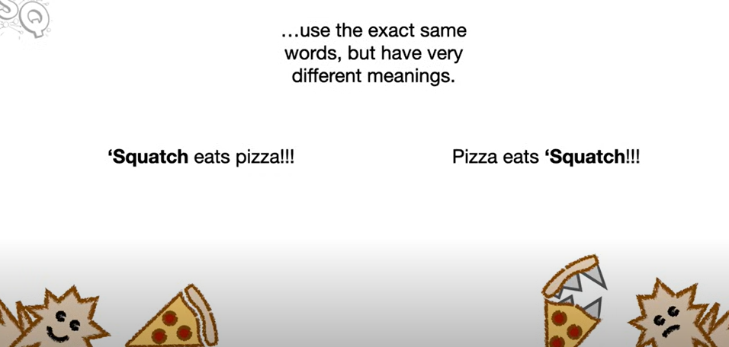

Slide 43
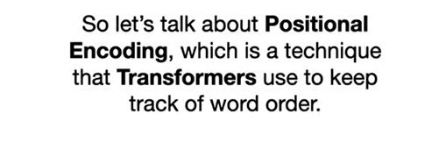

Slide 44
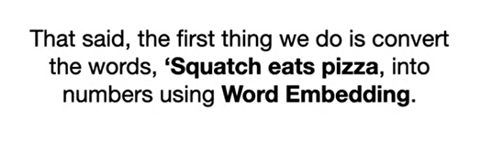

Slide 45
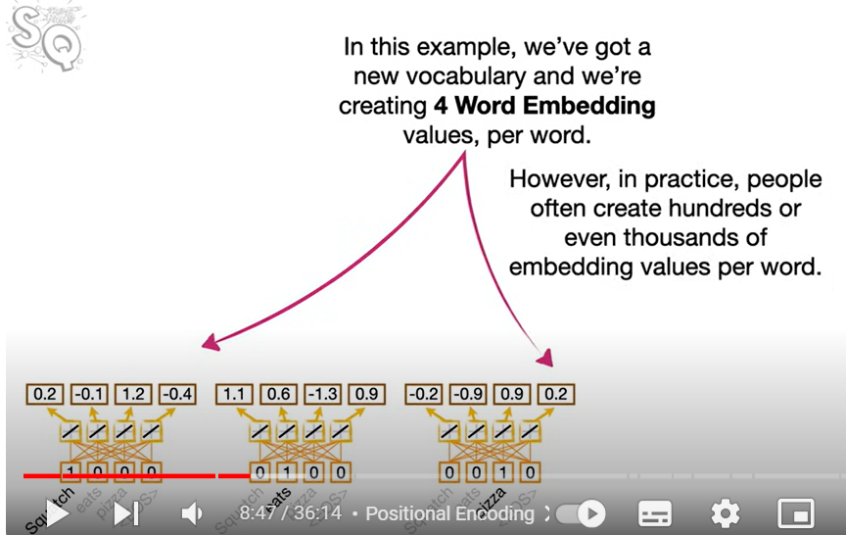

Slide 46
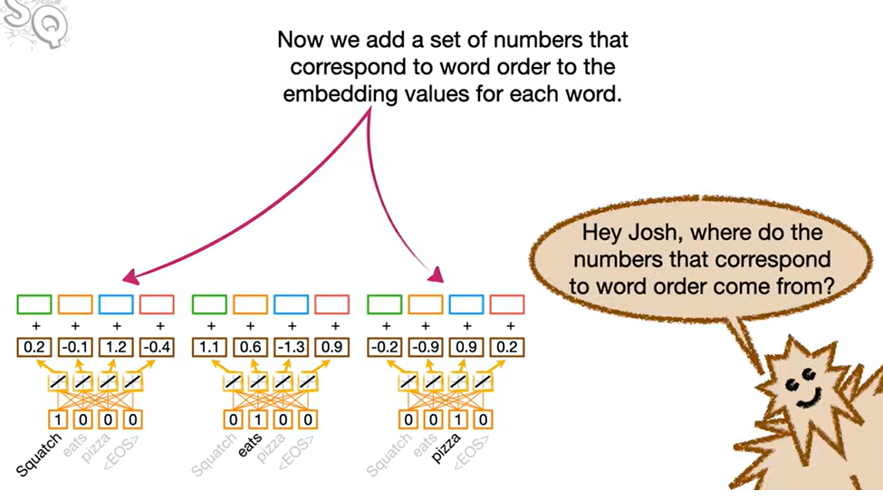

Slide 47
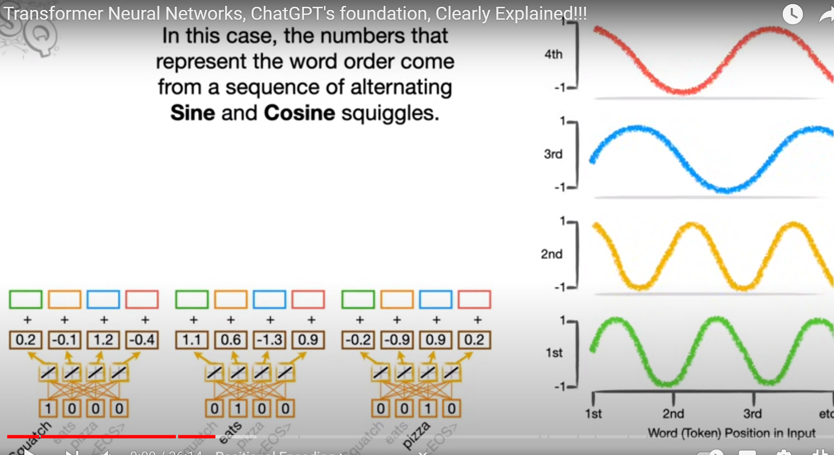

Slide 48
Skipping ahead

Slide 49
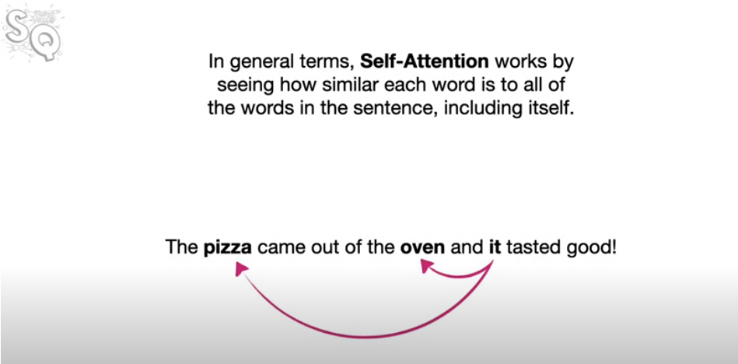

Slide 50
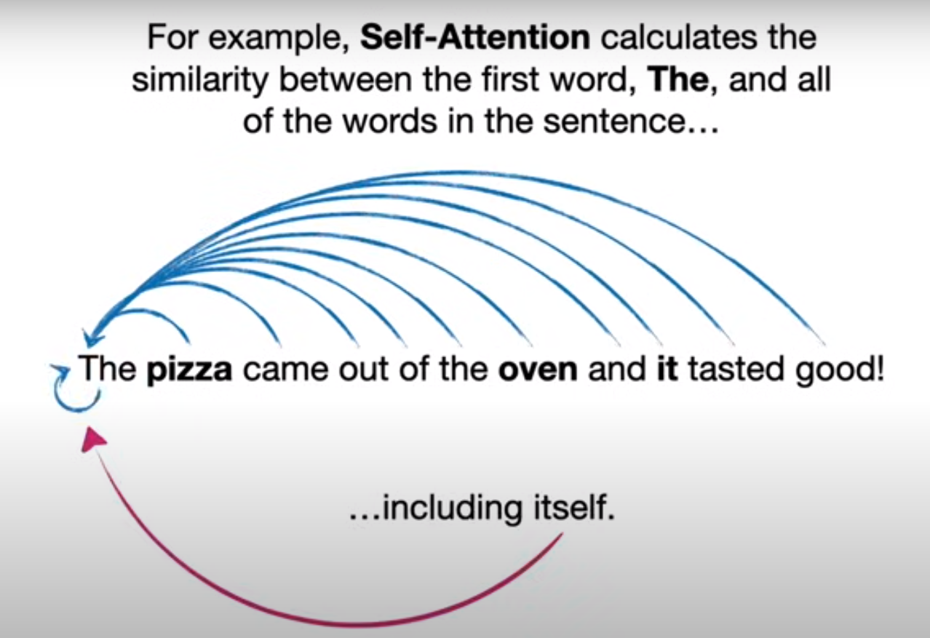

Slide 51
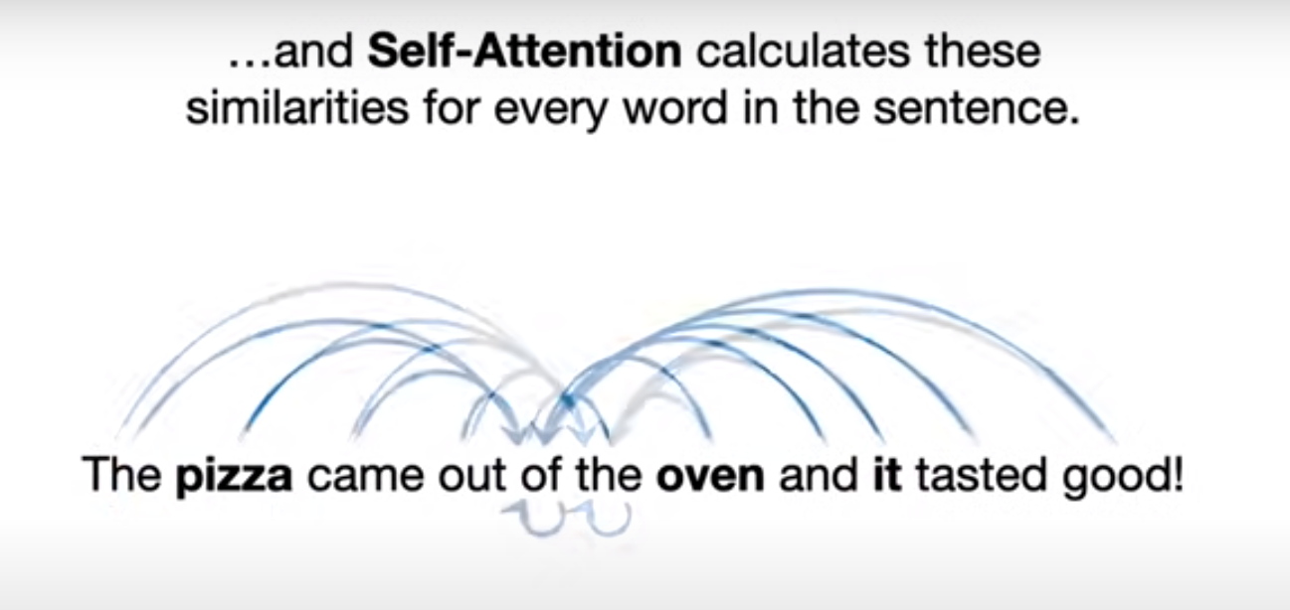

Slide 52
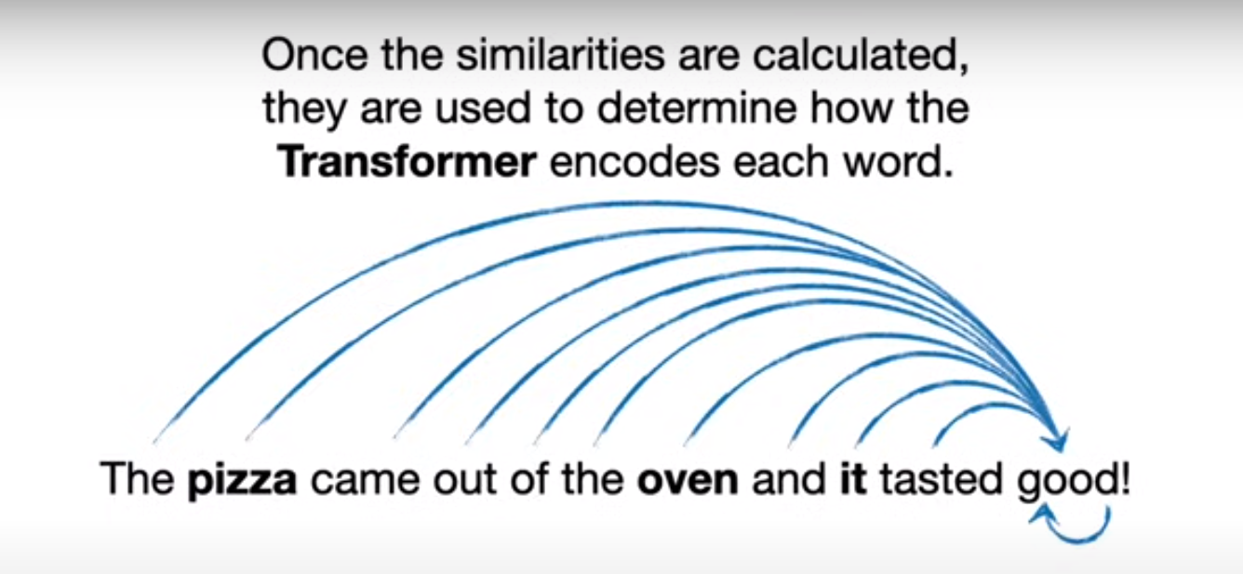

Slide 53
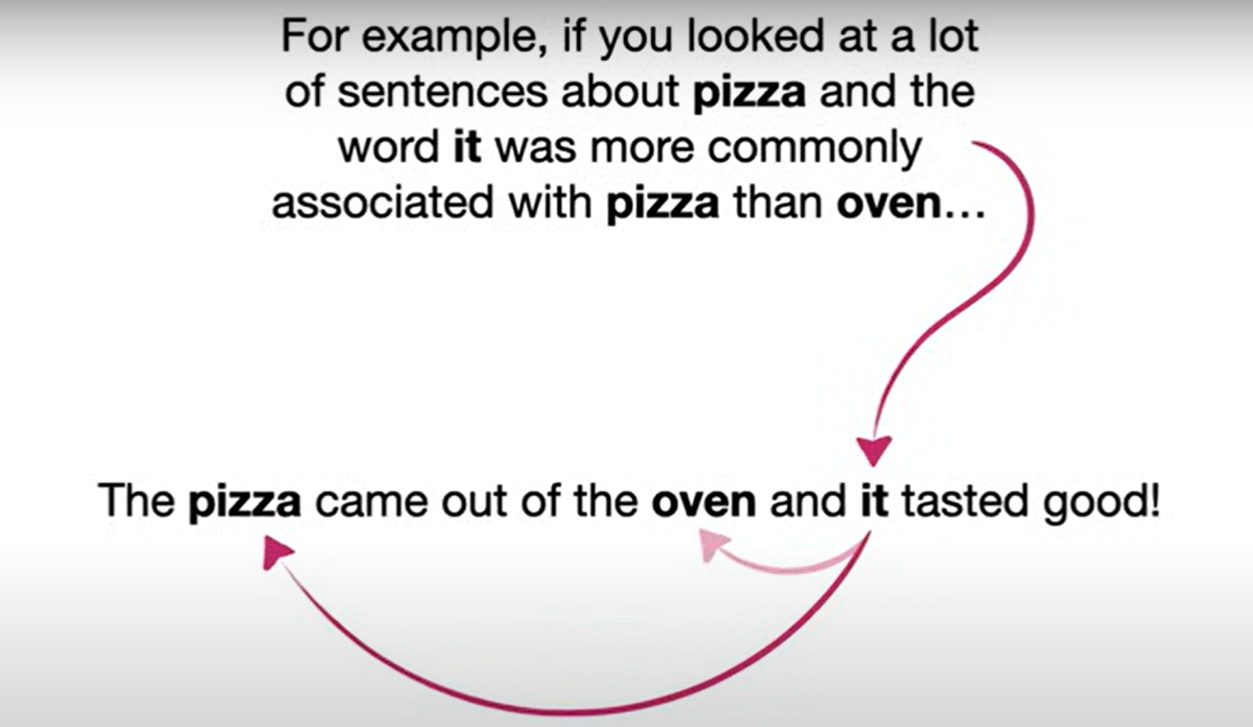

Slide 54
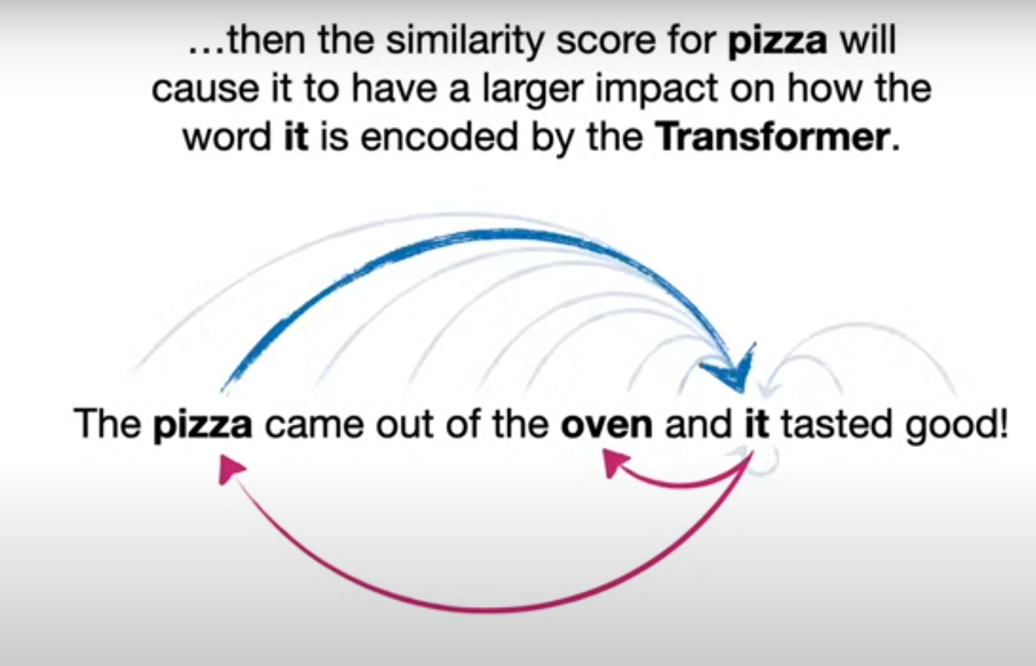

Slide 55
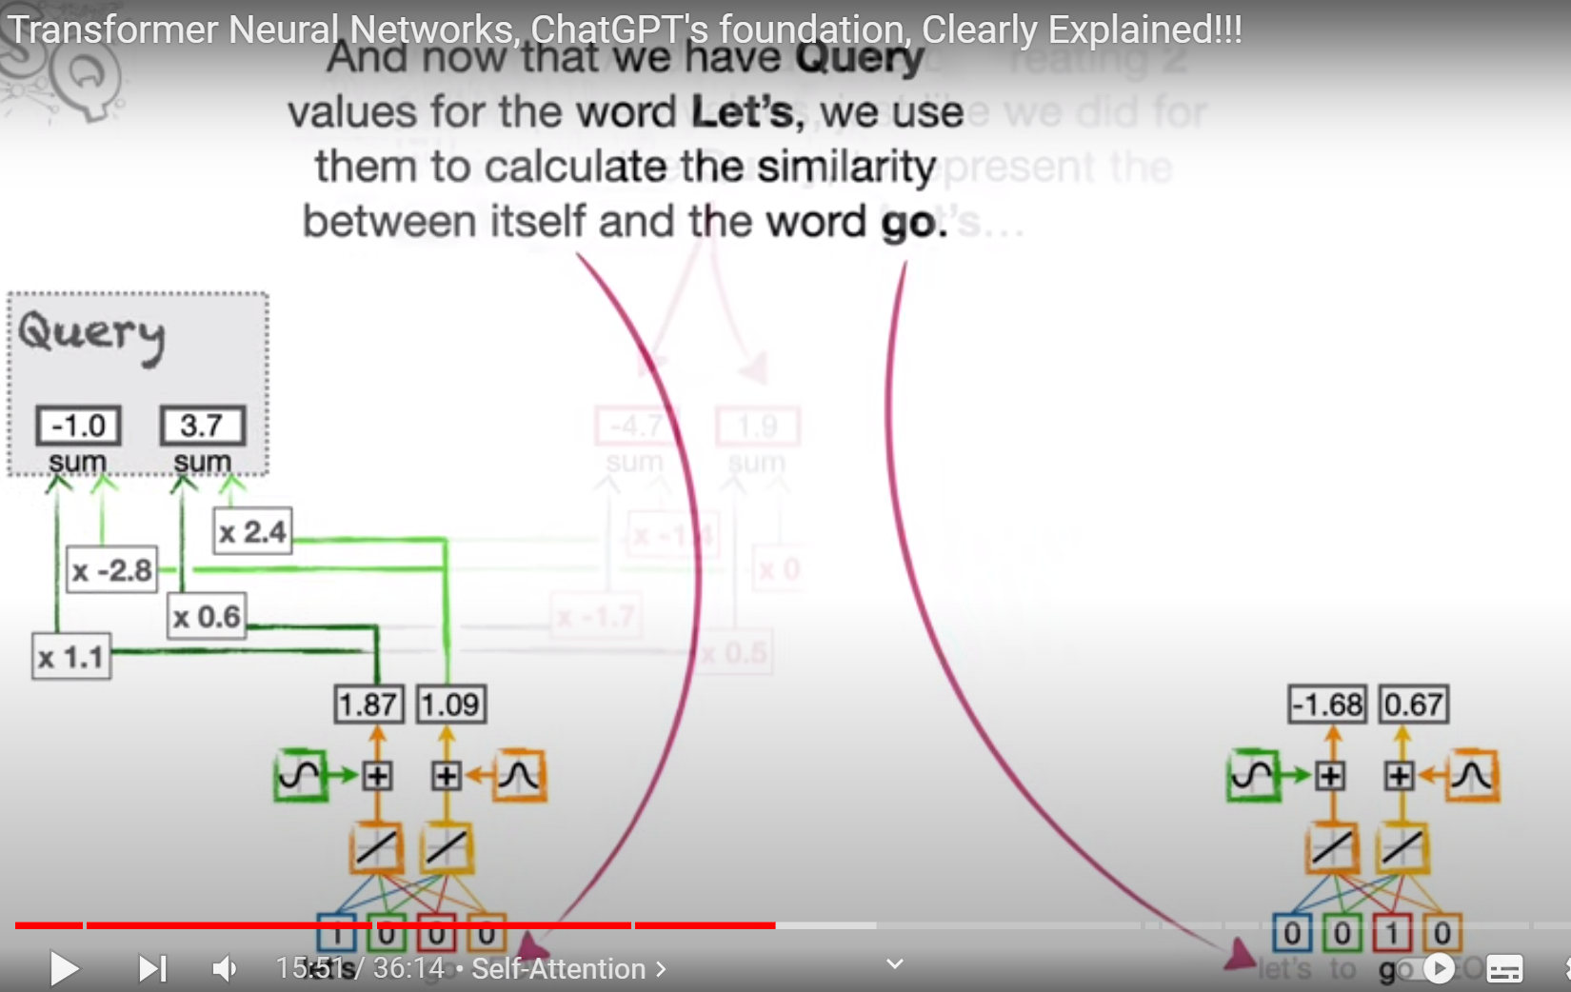

Slide 56


Slide 57


Slide 58


Slide 65
Homework!
https://www.kaggle.com/datasets/sunilthite/llm-detect-ai-generated-text-dataset
About Dataset
In this Dataset contains both AI Generated Essay and Human Written Essay for Training Purpose This dataset challenge is to to develop a machine learning model that can accurately detect whether an essay was written by a student or an LLM. The competition dataset comprises a mix of student-written essays and essays generated by a variety of LLMs.

